Slide 1

CSCI 5502: DATA MINING
Project Proposal
Stock Market Pattern Mining
Team Members:
Arnav Purushotham
Meghasrivardhan Pulakhandam
Sneha Nagaraju

Slide 2

INTRODUCTION
Problem:
  Stock data is vast, noisy, and hard to interpret.
  It is difficult to identify useful patterns just by observing price data.
Agenda:
  Train an ML model on past stock data.
  Use live prices from FinnHub API for real-time inference.
  Add latest analysis and news through GPT-4 API.
  Aggregate both signals for a final prediction.
Our Goal:
  Provide a more complete, real-time analysis rather than just raw predictions.
Why:
  Check if patterns can help predict short-term movements using Machine Learning.

Slide 3
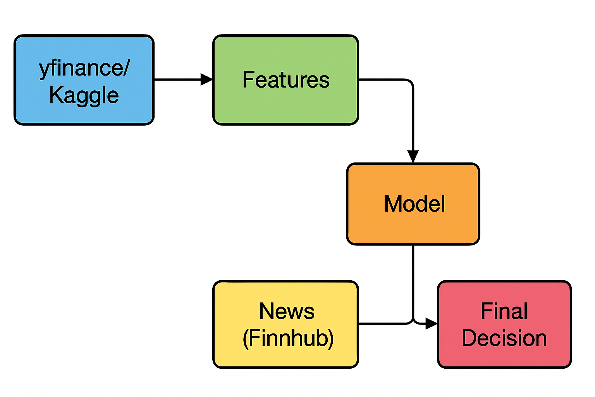
System
Architecture

Slide 4
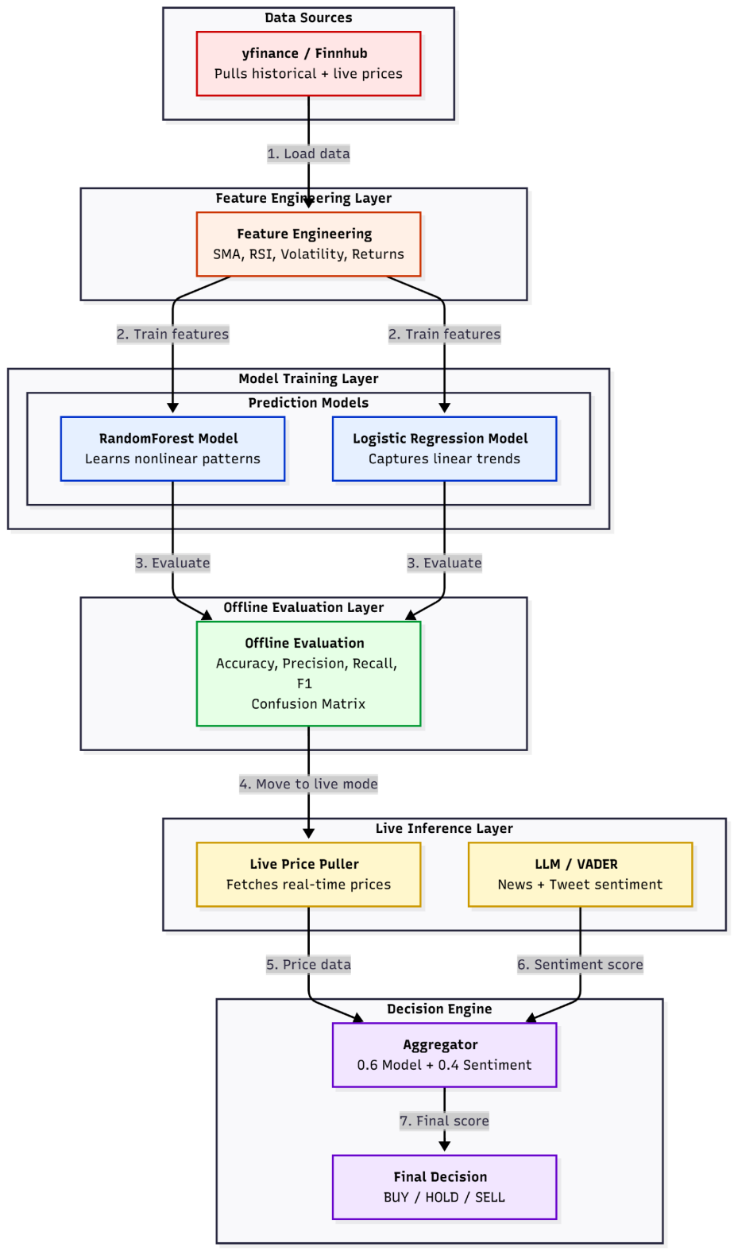
System
Architecture

Slide 5
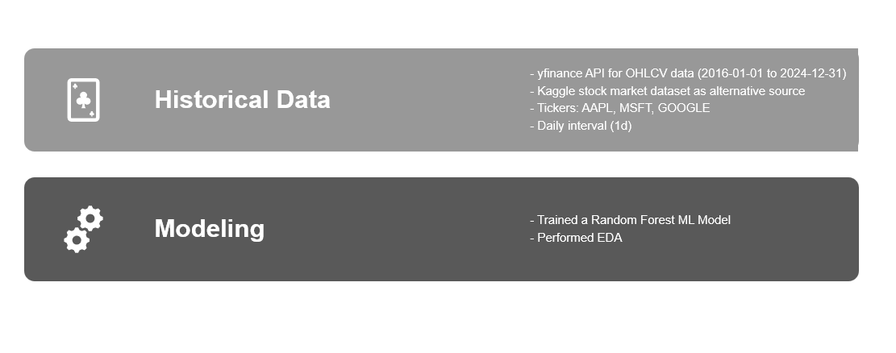
Data Source

Slide 6
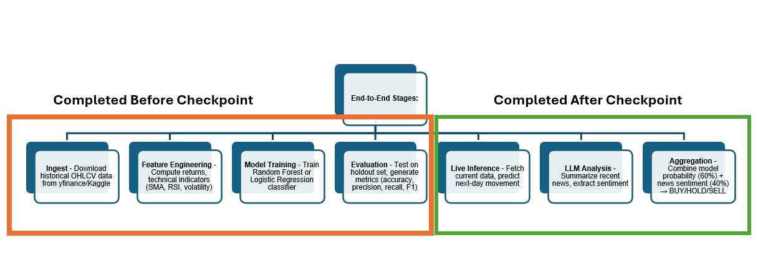
Pipeline Overview

Slide 7
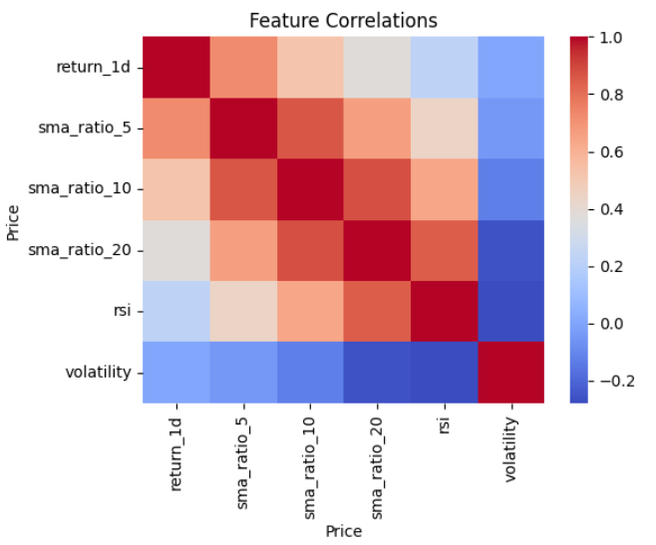
References From Data Set
Observations:
AAPL: Steady upward trend from 2016-2024, with notable dip in 2022 (market correction)
MSFT: Strong growth pattern, particularly accelerating post-2019; minor volatility during pandemic
GOOGLE: Similar upward trajectory with increased volatility in recent years
Key Insights:
All three tech stocks show long-term bullish trends
Visible seasonality: end-of-year rallies, summer lulls
COVID-19 impact visible (March 2020 crash, rapid recovery)
Recent consolidation period (2022-2023) across all tickers

Slide 8
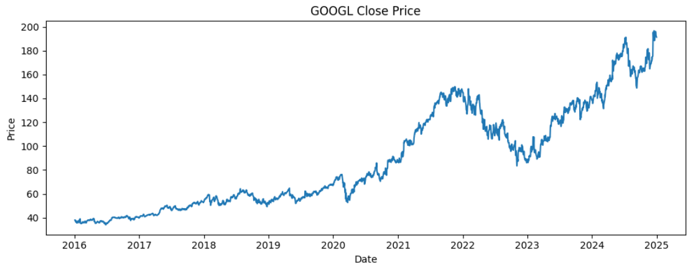
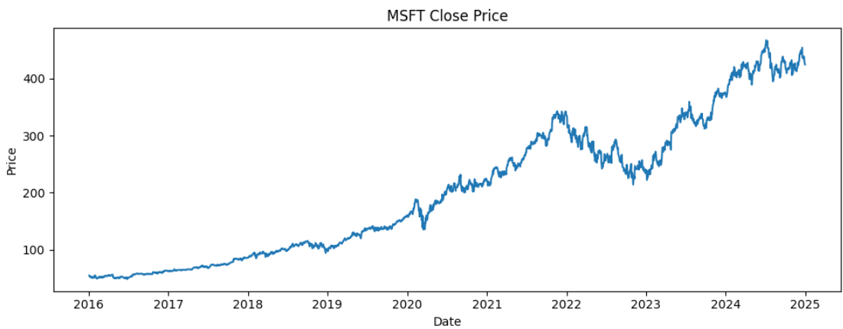
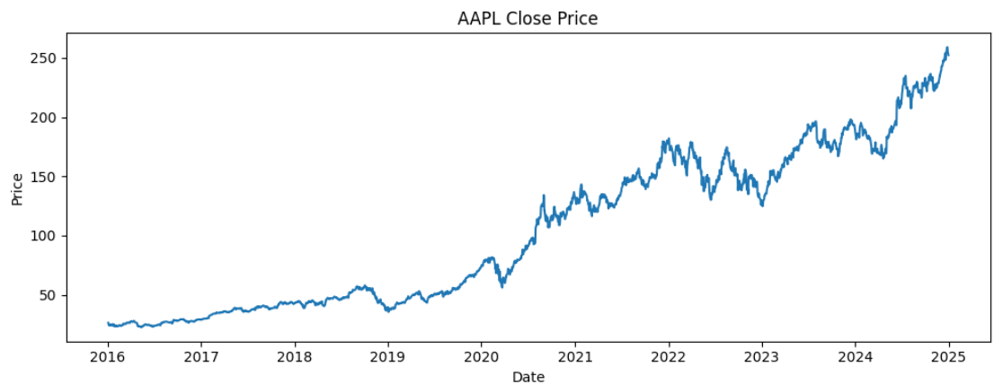
Sample Stock Closing Trends

Slide 9

EDA - Feature Correlation
Key Insights:
SMA ratios (5, 10, 20) are strongly correlated, as they track similar price trends at different time intervals.
RSI has weak correlation with SMA ratios, giving extra insight on momentum vs. trend.
Volatility is mostly independent, showing market uncertainty that isn’t tied to price movement.
1-day return shows moderate correlation with all indicators, supporting its predictive value.
Feature Engineering Highlights:
Indicators capture different aspects of price behavior.
Low multicollinearity among main features.
RSI and volatility add unique, non-trend information to the model.

Slide 10
Pattern Mining Overview
Goal: Identify frequent technical indicator combinations that precede price moves.
Techniques Used:
Apriori and FP-Growth algorithms on discretized indicators (SMA, RSI, volatility).
Thresholds: Support ≥ 0.05, Confidence ≥ 0.6, Lift > 1.0.
Example Pattern:
If (SMA5 > SMA10) and (RSI < 30) ⇒ Price Up Next Day
Support = 0.08, Confidence = 0.64, Lift = 1.28
Outcome:
Found stable crossover + volume patterns common to all 3 tickers.
Patterns visualized as a network graph (nodes = indicators, edges = lift).

Slide 11
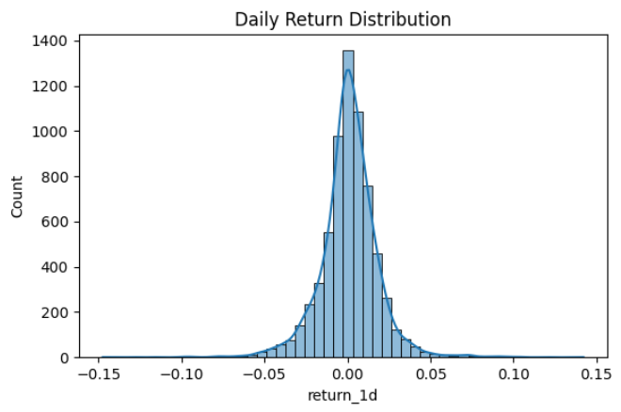
Daily Return Distribution
Most daily returns cluster tightly around 0%, showing market efficiency and short-term randomness.
The distribution has fat tails, meaning occasional large up/down moves (volatility spikes).
This supports including volatility and rolling returns as predictive features.

Slide 12
Feature Importance
Top Predictive Indicators (Random Forest Gini Scores):
SMA20 / SMA10 ratio – trend strength
Volatility (10-day std) – market uncertainty
RSI – momentum indicator
1-day return – short-term direction
Volume ratio – trading pressure
Insight:
Trend and momentum features dominate.
Volume adds context to volatility.
Confirms that interpretable indicators retain strong predictive value.

Slide 13
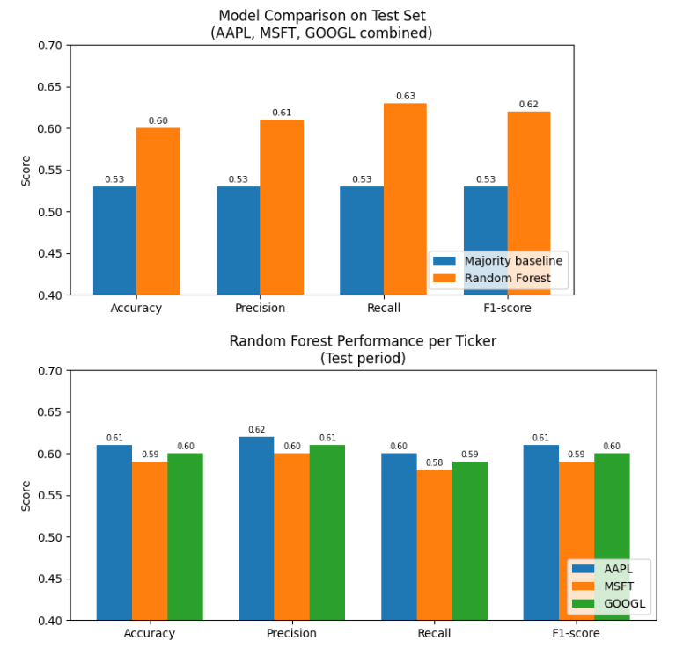
Key Findings & Insights
Short-term patterns like moving-average crossovers show moderate predictive power (lift > 1.2).
Random Forest outperformed baseline models by ≈ 15 percentage points in F1.
GPT-4 context improved interpretability and aligned predictions with market news.
Educational goal achieved, demonstrates how data mining connects technical indicators with ML outputs.

Slide 14
Limitations & Future Work
Limitations
Dataset limited to 3 tech stocks (2016–2024).
Daily data misses rich intraday signals.
Non-stationarity: Market patterns shift over time.
Future Work
Try transformer-based models for sequence forecasting.
Refine GPT-4 fusion via embedding similarity and entity tracking.
Add news embeddings instead of sentiment scores.
Deploy full dashboard with auto refresh and user interaction.

Slide 15
Conclusion
Our system demonstrates how data mining and machine learning can extract interpretable patterns from financial data and combine them with real-time context.
Rather than “beating the market,” we focus on educational value, pattern reliability, and transparent analytics.
This project connects historical ML models, live APIs, and LLM-based context into a single integrated framework for financial insight.

Slide 16

QUESTIONS

